Slide 1
WSA SUMMIT ON THE BLUE DROP, NO DROP AND GREEN DROP PROGRESS ASSESSMENT REPORT
SUPPORT BY SALGA TO MUNICIPALITIES’ ACTION PLANS
19 January 2024
Cllr Nikiwe Num – SALGA NEC

Slide 2
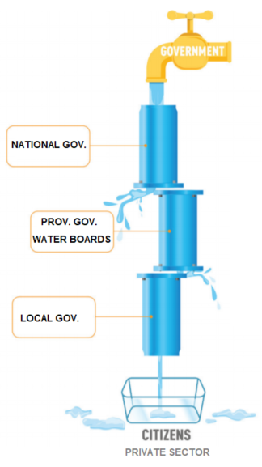
OUTLINE
SALGA Mandate
SALGA Water Services Programme Overview
Councillor Development Programme
Supporting Drop Programmes
2023 SALGA NMA Water Recommendations
SALGA Response to Group Presentations
Concluding Remarks

Slide 4
SALGA WATER SERVICES PROGRAMME
Programme Objective and Rationale:
Support municipalities in the provision of reliable and sustainable water services to all.
Provide support through all facets of the SALGA mandate in a differentiated manner.
Key Programme Components:
Municipal Functionality and Municipal Priority Action Plans (MPAP)
DWS-SALGA Five Year (2021-2026) Councillor Development Programme
Green Drop Support Programme
Blue Drop Support Programme
DWS-SALGA-DBSA National Water Partnership Office
Municipal Infrastructure Asset Management Improvement Programme

Slide 5
5- YEAR CLLR DEVELOPMENT PROGRAMME
Objective / Rationale:
Recognizes the need for continued professional development of Councillors, as is case for administrators.
Continue and progressively build Councillor knowledge to ensure they are well positioned to fulfill their legislated mandate.
Complement and reinforce DWS programmes (Blue Drop, No-Drop, Green Drop etc.) by equipping Councillors to play their leadership and oversight roles.
Progress to Date:
Trainings ongoing as outlined below:
Western Cape on 11-12 May 2023 (14 Cllrs), 16-17 May2023 (24 Cllrs), 22-23 June2023 (37 Cllrs), 29-30 August 2023 (43 Cllrs), Free State on 22 August 2023 (17 Cllrs), KwaZulu Natal on 1 Sept 2023 (14 Cllrs and 22 Officials) Limpopo on 6-7 September 2023 in Capricorn DM (11 Cllrs and 49 Officials) and on 20-21 September 2023 in Sekhukhune DM, Gauteng on 14 September 2023 (20 Cllrs and 19 Officials) and Mpumalanga on 28 – 29 September 2023 (42 officials).
Total of 180 Cllrs trained over and above induction.
Looking Forward:
Implement training in provinces that have not started: Northwest, Northern Cape and Eastern Cape.
Conclude development of and begin roll-out of Accredited 3-day and 5-day course for Councillors.
Collaboration between Councillors and officials, to continuously engage and educate communities.

Slide 6
GREEN DROP SUPPORT
Objective / Rationale:
Ensure that Section 24 of the Constitution is not violated (Human health and environmental protection).
Ensure municipal wastewater conveyance and treatment is effectively undertaken, in line with sector norms and standards.
Progress to Date:
Workshops for officials to create awareness and avail support.
5 Year Cllr Development Programme inclusive of Green Drop Programme.
Supported municipalities with responses to DWS and Draft Comprehensive Corrective Action Plans.
Lobbied DWS for increased support to municipalities.
Developed national green drop improvement programme, which is endorsed and supported by DWS and MISA.
Encourage WSAs to use a percentage of MIG allocations to fund the implementation of the action plans.
Looking Forward:
Continue implementation of Green Drop Improvement Programme with DWS and MISA.
Emphasize Asset Management component of the Green Drop programme.
Implement Green Drop Component of Councillor Development Programme.
Support Development of Wastewater Risk Abatement Plans.
Lobby for municipal Process Controller training funding with EWSETA.

Slide 7
BLUE DROP SUPPORT
Objective / Rationale:
Ensure that Section 27 of the Constitution is not violated (Access to safe drinking water).
Ensure municipal drinking water treatment is effectively undertaken, in line with sector norms and standards.
Progress to Date:
5 Year Cllr Development Programme inclusive of Blue Drop Programme.
Supported municipalities with responses to DWS and Draft Comprehensive Corrective Action Plans.
Lobbied DWS for increased support to municipalities.
Developed national green drop improvement programme, which is endorsed and supported by DWS and MISA.
Encourage WSAs to use MIG allocations to fund action plans.
Looking Forward:
Develop Blue Drop improvement programme with sector partners.
Support municipalities with blue drop corrective action plan development and implementation.
Emphasise Asset Management component of the Blue Drop programme.
Implement Blue Drop Component of Councillor Development Programme.
Support Development of Water Safety Plans.
Lobby for municipal Process Controller training funding with EWSETA.

Slide 8
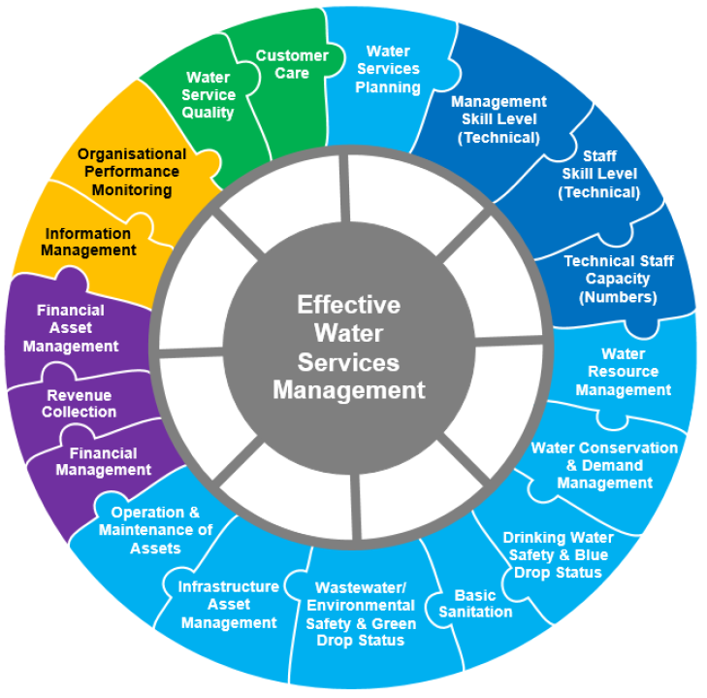
2023 SALGA NATIONAL MEMBERS ASSEMBLY (NMA)

Slide 9
2023 SALGA NMA - Overview & Recommendations
Commission 7 Topic: Towards sustainable water services provider mechanisms
Commission Context: Undesirable state of municipal water and sanitation services.
Recommendation One: Build the capacity of Water Services Authorities –
Recommendation Two: COGTA to complete the review of powers and functions for water services to address underlying structural challenges such as institutional fragmentation, lack of financial viability, loss of economies of scale, and overall lack of sustainable water services.
Recommendation Three: Obligations of national and provincial government in terms of Section 154 support to be explored including a tool to measure support.
Recommendation Four: Lobby for the establishment of an Inter-Ministerial Committee for water and sanitation services at both political and technical level. (quantification of impact related to load shedding on water and sanitation services is available, proposals are available, only a platform required to process such matters, which the Inter-Ministerial Committee is a perfect solution to process such strategic areas.

Slide 10
SUPPORT TO ENSURE SUSTAINABILITY
Based on the work undertaken during this Summit it is clear that most municipalities will require significant support to ensure ongoing sustainable water and sanitation services provision.
We support that municipalities as Water Services Authorities (WSAs) be encouraged and supported to undertake the section 78 (1) process as outlined in Chapter 8 of the Municipal Systems Act, when assessing and deciding on a mechanism to provide a municipal service. This important step allows us to identify all the gaps that we have discussed during this Summit and come up with holistic improvement plans for our Water Services Providers.
This internal mechanism assessment will also supplement the Blue, Green and No-Drop assessments and Corrective Action Plans to provide an overall picture of the capacity of the Water Services Provider and how re-organisation as referred to in Chaper 8 of the Systems Act can be utilised to improve the service through the internal mechanism.
We therefore recommend that DWS, COGTA, NT and SALGA set up a joint facility to support municipalities to undertake these assessments objectively and in terms of legislated process in the Systems Act, which also requires Council resolution.

Slide 11
IN CONCLUSION
Any work done to support a municipality must consider the whole municipality (Community, Council and Administration) as it will take the whole to make any lasting and sustainable change.
There can be no success without meaningful collaboration between all stakeholders.
The positive impact of continuous Councillor training and development should not be underestimated. A capacitated leadership is a capable leadership.
Differentiation, responsiveness and agility in support are critical. Municipalities are similar and different. One size fits all does not work.
Some change will be immediate and other changes will take time. We must therefore have reasonable expectations.
We all have role to play in creating an enabling environment for municipal success and sustainability.

Slide 12
Thank You

